Slide 1

Delegates and anonymous methods
Lecturer
Rokas Slaboševičius
Data

Slide 2
Today you will learn
Delegates and anonymous methods
Who are the delegates?
01
What are anonymous functions?
02

Slide 3
Delegate
Delegates and anonymous methods
Just as a class object is a reference to data in memory, a delegate is a variable of reference type to a method.
Creating a delegate consists of specifying the scope (private/public etc.), specifying that it is a delegate ("delegate"), specifying what data type return method it will be (string, int etc.), the name of the delegate and the parameters (string s).
private delegate int NumberChanger(int number);
Such a delegate will be able to reference any method that returns int and has a single int variable in its parameters.
The reference to which method the delegate points to may change during runtime

Slide 4
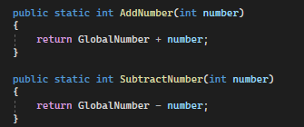


Creating a delegate
First declare a delegate
Second, we create functions that are appropriate for our delegate
Third, initialise the delegate
Fourthly, we invite the methods referred to by delegates

Slide 5
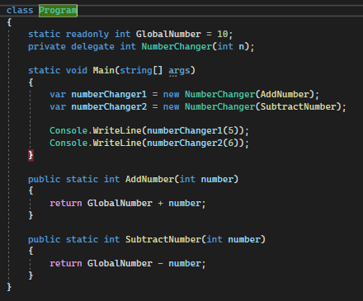
Creating a delegate
When you run this program, a delegate will be created, methods AddNumber, SubtractNumber.
The delegates numberChanger1 and numberChanger2 are then initialized and the methods created are assigned to them.
Once delegates are initialized, they become variables with a pointer to the method.
To call the method pointed to by the delegate, you just need to specify the delegate object with the appropriate parameters.

Slide 6

Delegates and anonymous methods
Task 1
Create a delegate that points to a method with a string return type and three parameters firstName, lastName and age. Call the delegate method.
Create a delegate that points to a method with an int return type and two parameters number1 and number2. Call the delegate method.
Create a delegate that points to a method with List<int> return type and two parameters List<int> and int step, the essence of the method will be to return the next element (every next element is specified by the "step" parameter). Call the delegate method.
Create a delegate that points to the GetType<T> method with return type string and parameter T element, the method returns the data type of the element variable. Call the delegate method.

Slide 7
Anonymous methods
Delegates and anonymous methods
Anonymous methods are, as the name implies, methods without a name
Anonymous methods are created using the delegate keyword and can be assigned to variables of type delegate

Slide 8
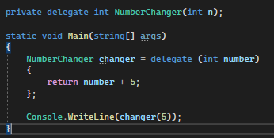
Anonymous methods
Delegates and anonymous methods
First we create a delegate
Second, we initialize the created delegate and assign a value to it immediately when describing the function.

Slide 9
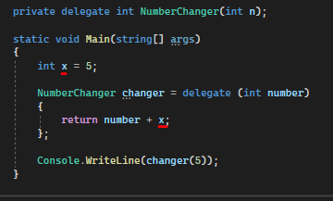
Anonymous methods
Delegates and anonymous methods
Anonymous methods also see the external scope variables

Slide 10
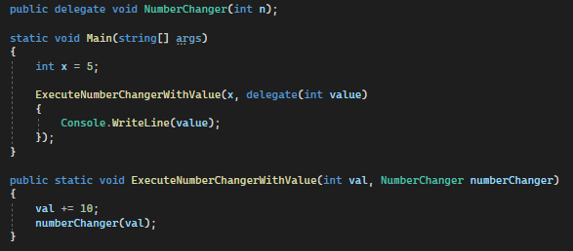
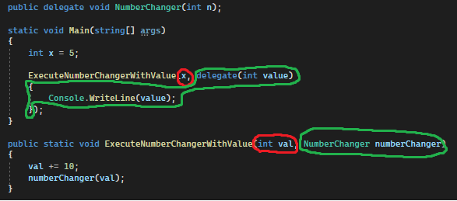
Anonymous methods
Delegates and anonymous methods
An anonymous method can also be passed as a parameter to another method

Slide 11
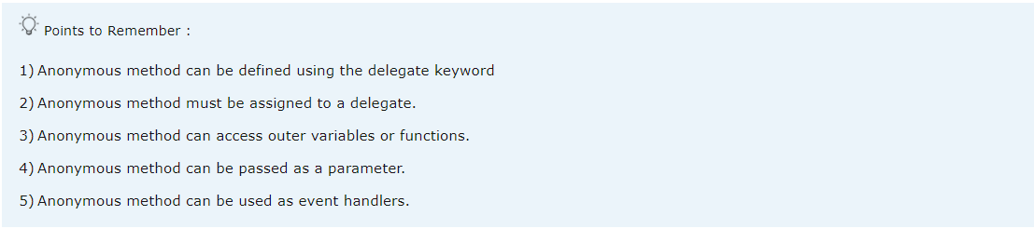
Delegates and anonymous methods

Slide 12
Delegates and anonymous methods
Task 2
Rework the "Task 1" tasks to use anonymous functions instead of regular functions to initialize delegates.

Slide 13
Delegates and anonymous methods
Task 3
Create a Person class with string name and int age
In the Main method, create a list of people with different names and ages
Create a Filter delegate that returns a bool and takes a Person object as a parameter.
Create three methods that will return bool values and accept Person as a parameter, one method will check if the person is a child < 18 years old, one will check if the person is an adult >= 18 years old and one will check if the person is a senior citizen >= 65 years old.
Create a DisplayPeople method, with title, List<Person> and Filter delegate. The essence of the method will be to loop through the persons and run a filter passed through the parameters to check if the person is, for example, a child.
The method call will look something like this: displayPeople("Children:", people, IsChild);

Slide 14
Lecture title
Delegates and Anonymous methods
https://www.tutorialspoint.com/csharp/csharp_delegates.htm
https://www.tutorialsteacher.com/csharp/csharp-anonymous-method
Useful information

